Slide 1
Easy Visa
Advanced Machine Learning
3 May 2026

Slide 2
Contents / Agenda
Executive Summary
Business Problem Overview and Solution Approach
EDA Results
Data Preprocessing
Model Performance Summary
Appendix

Slide 3
Executive Summary
The growing demand for skilled labor in the United States has led to a significant increase in visa applications processed by the Office of Foreign Labor Certification (OFLC)
Manual evaluation of these applications is becoming time-consuming and inefficient, creating a need for a scalable, data-driven solution
This project uses machine learning to predict visa certification outcomes and identify the key factors influencing approval decisions
Analysis of 25,000+ applications highlights the importance of factors such as education, work experience, job type, and wage characteristics
The final model enables efficient shortlisting of high-probability candidates, improving decision-making consistency
Implementing this solution can help:
Reduce processing time
Improve accuracy and consistency in approvals
Support better workforce planning for employers

Slide 4
Business Problem Overview
Business Problem Overview:
U.S. business communities face increasing demand for skilled labor and often rely on foreign workers to address workforce shortages
Under the Immigration and Nationality Act (INA), employers must demonstrate that hiring foreign workers will not negatively impact U.S. workers
The Office of Foreign Labor Certification (OFLC) is responsible for reviewing and certifying visa applications
Challenge:
In FY 2016 alone:
775,979 applications processed
1.69 million positions requested
The volume of applications is increasing each year, making manual review inefficient and resource-intensive
Key Problem:
Difficulty in efficiently identifying candidates with a high likelihood of visa approval

Slide 5
Solution Approach and Outcome
Solution Approach
Develop a machine learning classification model to predict visa certification outcomes
Perform Exploratory Data Analysis (EDA) to identify patterns and key drivers of approval
Apply data preprocessing techniques to prepare data for modeling
Build multiple classification models, including:
Decision Tree
Random Forest
Bagging and Boosting methods
Address class imbalance using:
Oversampling and under sampling techniques
Optimize model performance using:
Cross-validation
Hyperparameter tuning
Outcome:
Provide a data-driven system to:
Facilitate faster visa approvals
Recommend suitable applicant profiles
Support consistent and scalable decision-making

Slide 6
Data Overview
Overview of the Dataset
The dataset consists of 25,480 visa application records with 12 variables capturing employee, employer, and job-related information.
Preview of the Data
A snapshot of the dataset (first and last 5 rows) shows the structure and types of information available. Each row represents a unique visa application and includes:
Employee details: continent, education level, work experience, training requirement
Employer details: company size (number of employees), year established
Job details: region of employment, wage, wage unit, full-time status
Target variable: case_status (Certified or Denied)
From the sample data:
Applicants come from multiple continents, with a strong presence from Asia
Education levels vary from High School to Doctorate
Wage values vary significantly depending on unit (hourly vs yearly)
Both certified and denied cases are present in the dataset
Dataset Dimensions
Number of observations (rows): 25,480
Number of features (columns): 12
Key Observations
Each record is uniquely identified by a case_id
The dataset contains a mix of categorical and numerical variables
The target variable case_status indicates whether a visa was approved (Certified) or rejected (Denied)
There is noticeable variation in wages, company sizes, and employment regions, which may influence visa outcomes
Summary
Overall, the dataset provides a comprehensive view of visa applications, combining demographic, economic, and employment-related factors. These variables will be used to identify patterns and build predictive models for visa approval.

Slide 7
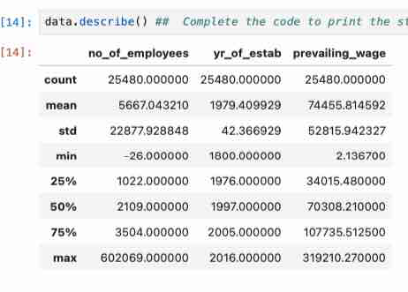
EDA Results – Descriptive Statistics
1. Number of Employees
The average number of employees is ~5,667, while the median is much lower at ~2,109
This indicates a right-skewed distribution, where a few very large companies significantly increase the average
The maximum value (602,069) confirms the presence of large outliers
Negative values were observed and corrected using absolute transformation
Insight: Most visa applications come from small to mid-sized companies, with a few large organizations contributing to extreme values.
2. Year of Establishment
The average year of establishment is ~1979, while the median is ~1997
The dataset includes companies ranging from very old (1800) to recent (2016)
Insight: Visa applications are submitted by a diverse mix of both well-established and relatively new companies
3. Prevailing Wage
- The average wage is ~$74,456, with a median of ~$70,308
- The wide range (from ~$2 to ~$319,210) indicates high variability in wages
- The distribution is slightly right-skewed, with some high-paying roles
Insight: Wage levels vary significantly across applications and may play an important role in determining visa approval outcomes.
.

Slide 8
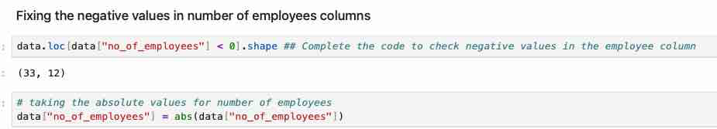
EDA Results: Handling of Negative Employee Numbers
Handling Invalid Values in no_of_employees
I identified records where the number of employees was negative, which is not logically valid.
A total of 33 rows contained negative values in this column.
Why this matters:
Negative employee counts are data errors and can distort analysis and model performance
Action Taken:
I applied an absolute value transformation to convert negative values into positive values
Rationale:
I assumed that the magnitude of the value is correct and only the sign is incorrect
Outcome:
Data quality is improved without losing any record

Slide 9
EDA Results – Analysis of Categorical Data
Summary
This analysis highlights key patterns in the dataset, including dominance of certain categories and class imbalance. These insights will guide feature selection, preprocessing, and model development.
To better understand the dataset, I examined the distribution of all categorical variables by counting the frequency of each category.
Why this is important:
Helps identify dominant patterns in the data
Detects class imbalance
Provides insights into factors that may influence visa approval
Job Training Requirement
Most applicants do not require job training (~88%)
Insight:
The majority of candidates are job-ready
Key Observations
Case ID
Each value appears only once (25,480 unique values)
This confirms it is a unique identifier
Action:
I removed this column as it does not contribute to prediction
Region of Employment
Applications are distrib uted across major U.S. regions
Insight:
Demand for foreign workers exists across multiple regions
Unit of Wage
Majority of wages are yearly-based (~90%)
Insight:
Most roles are stable, full-time salaried positions
Continent
Majority of applicants are from Asia (~66%)
Insight:
The dataset is geographically imbalanced, which may influence model predictions
Full-Time Position
Most roles are full-time (~89%)
Insight:
Visa applications are primarily for long-term employment
Education Level - Most applicants have Bachelor’s or Master’s degrees **Insight:** - The dataset is dominated by highly educated individuals
Case Status (Target Variable)
Certified: 17,018
Denied: 8,462
Insight:
The dataset is moderately imbalanced, with more approvals than denials
This imbalance will need to be addressed during model building
Job Experience - More applicants have prior work experience than not Insight: - Work experience may be an important factor in visa approval

Slide 10
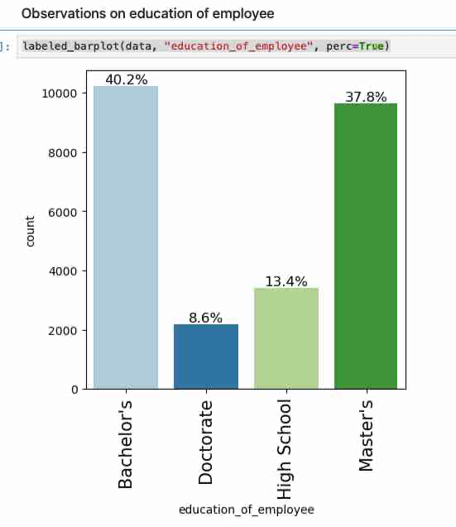
EDA Results – Univariate Analysis (Educational Level Distribution)
Education Level Distribution
The distribution of applicants by education level shows that:
Bachelor’s degree holders account for 40.2% of applicants
Master’s degree holders account for 37.8%
High School graduates account for 13.4%
Doctorate holders account for 8.6%
Interpretation
The dataset is heavily concentrated around mid-level higher education (Bachelor’s and Master’s), which together make up nearly 78% of all applicants
There is relatively low representation of applicants at the extremes (High School and Doctorate levels)
Why This is Important
Education level is likely a key determinant of visa approval, as higher education is often associated with specialized skills and higher-paying jobs
The imbalance in categories means the model will have more exposure to mid-level education groups, which may influence predictions
Business Insight
The high proportion of Bachelor’s and Master’s degree holders suggests that visa applications are primarily driven by skilled professionals
Employers are likely targeting candidates with strong academic backgrounds to meet workforce demands
Understanding how education impacts approval can help:
Improve candidate screening
Align hiring with skill requirements
Increase approval success rates
Summary
Education level is a critical feature in the dataset, with most applicants being well-qualified. This reinforces the importance of education as a driver of visa approval outcomes.

Slide 11
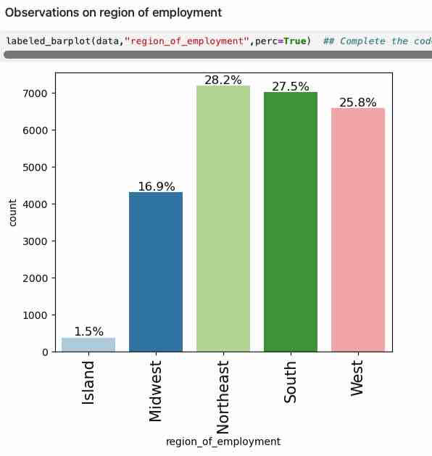
EDA Results – Univariate Analysis (Regional Employment)
Region of Employment Distribution¶
The distribution of visa applications across regions shows that:
Northeast (28.2%), South (27.5%), and West (25.8%) account for the majority of applications
Midwest (16.9%) has a moderate share
Island regions (1.5%) have very few applications
Interpretation
Visa applications are concentrated in major economic regions of the United States
The Northeast, South, and West together account for over 80% of total applications, indicating higher demand for foreign workers in these areas
The very low representation in Island regions suggests limited employment opportunities or lower demand in those areas
Why This is Important
The region of employment may influence visa approval due to:
Differences in industry presence (e.g., tech, finance, manufacturing)
Regional labor shortages
Economic activity levels
Since the data is not evenly distributed across regions, the model may learn stronger patterns from the dominant regions
Business Insight
Employers in the Northeast, South, and West are the primary drivers of visa applications, likely due to higher economic activity and demand for skilled labor
Understanding regional demand can help:
Target hiring strategies
Optimize workforce planning
Improve visa approval predictions based on location trends

Slide 12
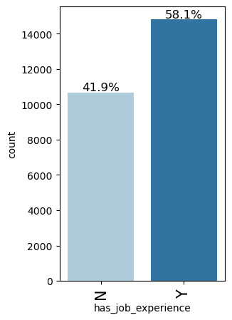
EDA Results – Univariate Analysis (Job Experience)
Job Experience Distribution
The distribution of job experience among applicants shows that:
58.1% of applicants have prior job experience (Y)
41.9% of applicants do not have prior job experience (N)
Interpretation
A majority of applicants have relevant work experience, indicating that most candidates are already skilled professionals
However, a substantial portion (~42%) lacks prior experience, suggesting a mix of entry-level and experienced applicants
Why This is Important
Job experience is likely a key factor influencing visa approval, as employers may prefer candidates who can contribute immediately
The presence of both experienced and inexperienced candidates allows the model to learn how experience impacts approval outcomes
Business Insight
Employers appear to favor candidates with prior experience, which may increase the likelihood of visa certification
Identifying the role of experience can help:
Improve candidate shortlisting
Align hiring strategies with workforce needs
Support more accurate visa approval predictions

Slide 13
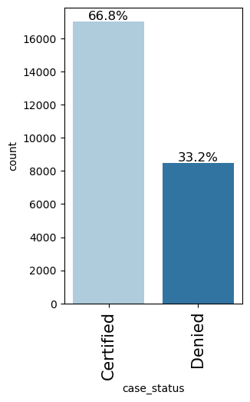
EDA Results – Univariate Analysis (Case Status)
Case Status Distribution
The distribution of visa application outcomes shows that:
66.8% of applications are Certified
33.2% of applications are Denied
Interpretation
A significantly larger proportion of visa applications are approved rather than denied
This indicates that the dataset is moderately imbalanced, with approvals forming the majority class
Why This is Important
Class imbalance can impact model performance:
The model may become biased toward predicting the majority class (Certified)
It may perform poorly in identifying denied cases
This imbalance needs to be addressed during model building using techniques such as:
Oversampling
Under sampling
Business Insight
The relatively high approval rate suggests that many applicants meet the required criteria for certification
However, identifying the factors that lead to denial is equally important, as it helps:
Improve candidate screening
Reduce unsuccessful applications
Enhance decision-making efficiency
Summary
The imbalance in case status highlights the importance of building a model that can accurately predict both approvals and denials, ensuring balanced and reliable decision-making.

Slide 14
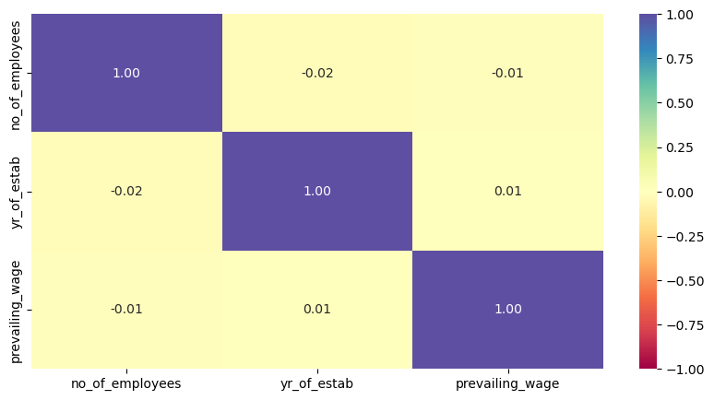
EDA Results – Bivariate Analysis (Correlation Check)
Correlation Analysis of Numerical Variables
A correlation heatmap was used to examine the relationships between numerical variables:
no_of_employees
yr_of_estab
prevailing_wage
Key Observations
The correlation values between variables are very close to 0:
no_of_employees vs yr_of_estab: -0.02
no_of_employees vs prevailing_wage: -0.01
yr_of_estab vs prevailing_wage: 0.01
Interpretation
There is no strong linear relationship between any pair of numerical variables
The variables appear to be independent of each other in terms of linear correlation
Why This is Important
Low correlation means:
No multicollinearity issues
Each variable contributes unique information to the model
This is beneficial because:
Highly correlated variables can distort model performance
Independent features improve model reliability and interpretability
Business Insight
Company size (no_of_employees), company age (yr_of_estab), and wage levels (prevailing_wage) operate independently
This suggests that:
Large companies do not necessarily offer higher wages
Older companies are not strongly associated with higher or lower wages
Each factor may influence visa approval in different ways, rather than being interconnected
Summary
The correlation analysis indicates that there are no strong relationships between numerical variables. This suggests that all features can be retained for modeling, as they provide distinct and non-redundant information

Slide 15
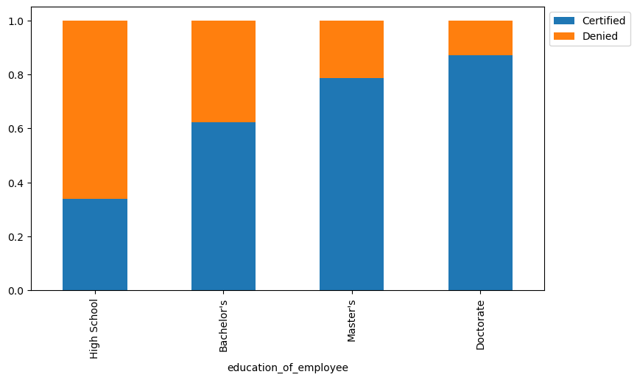
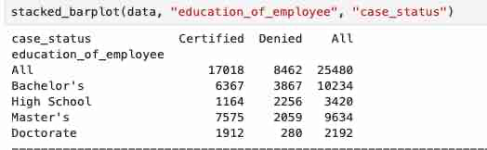
EDA Results: Bivariate Analysis -- Does education level influence visa approval?
Education Level vs Visa Approval (Case Status)
To understand whether education level influences visa approval, I analyzed the relationship between education_of_employee and case_status using a stacked bar plot.
Key Observations¶
From the distribution:
Doctorate holders have the highest approval rate (~87%)
Master’s degree holders also show a high approval rate (~79%)
Bachelor’s degree holders have a moderate approval rate (~62%)
High School applicants have a significantly lower approval rate (~34%)
Interpretation
There is a clear positive relationship between education level and visa approval
As the level of education increases, the likelihood of visa certification also increases
High School applicants are more likely to be denied compared to other groups
Why This is Important
This confirms that education is a strong predictor of visa approval
It highlights that employers and certification authorities likely favor:
Highly educated candidates
Individuals with specialized skills
This variable will likely be a key feature in the model
Business Insight
Employers seeking visa approval should prioritize candidates with:
Master’s or Doctorate degrees
Candidates with lower education levels may face higher rejection rates and should:
Improve qualifications
Gain additional skills or certifications
This insight can help:
Improve candidate screening
Increase visa approval success rates
Align hiring strategies with approval patterns
Summary
Education level has a significant impact on visa approval outcomes, with higher education strongly associated with increased chances of certification. This makes it one of the most important factors in predicting visa approval.

Slide 16
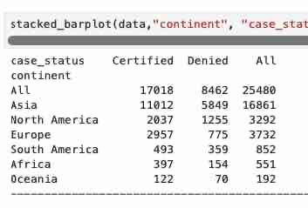
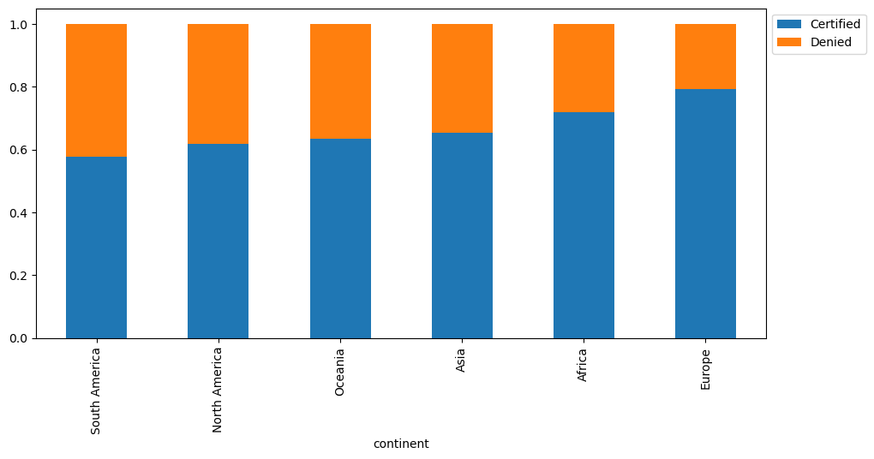
EDA Results – Bivariate Analysis: How does visa status vary across different continents?
Continent vs Visa Approval (Case Status)
To understand how visa approval varies across different regions, I analyzed the relationship between continent and case_status.
Key Observations
Europe has the highest approval rate (79%)
Africa (72%) and Asia (65%) also show relatively strong approval rates
North America (62%) and Oceania (64%) show moderate approval rates
South America has the lowest approval rate (58%)
Interpretation
Visa approval rates vary across continents, indicating that geographic origin influences certification outcomes
Applicants from Europe and Africa have higher approval rates compared to other regions
South America shows relatively lower approval rates, suggesting possible differences in applicant profiles or job types
Why This is Important
This shows that continent is an influential categorical variable in predicting visa approval
Geographic differences may reflect:
Variation in skill levels
Industry demand
Types of roles applied for
The model can leverage this information to improve prediction accuracy
Business Insight
Employers may experience higher success rates when hiring candidates from regions with historically higher approval rates
Regions like Europe and Asia appear to be strong sources of approved candidates, indicating alignment with U.S. labor market demands
Lower approval regions may require:
Better candidate screening
Improved qualification matching
Summary
Visa approval rates differ across continents, with Europe and Africa showing higher certification rates and South America showing lower rates. This suggests that geographic origin plays a role in visa outcomes and should be considered in decision-making and predictive modeling.

Slide 17
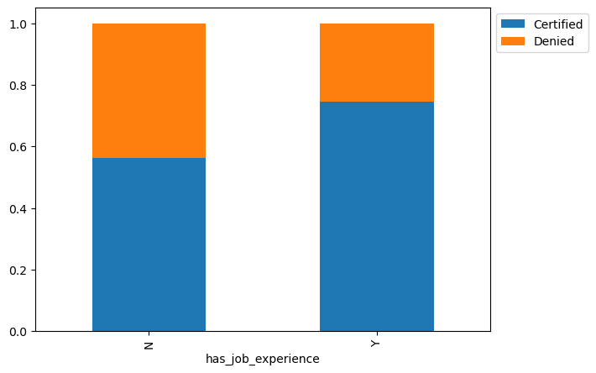
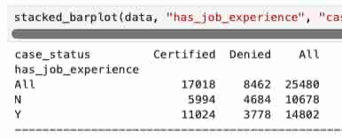
EDA Results – Bivariate Analysis: How does visa status vary across different continents?
Job Experience vs Visa Approval (Case Status)
To evaluate whether prior work experience influences visa approval, I analyzed the relationship between has_job_experience and case_status.
Key Observations
Applicants with prior work experience (Y) have a higher approval rate (~74%)
Applicants without work experience (N) have a lower approval rate (~56%)
Interpretation
There is a clear positive relationship between work experience and visa approval
Candidates with prior experience are significantly more likely to be certified compared to those without experience
Why This is Important
Work experience is a strong predictor of visa approval
Employers and certification authorities likely prefer candidates who can:
Contribute immediately
Require less training
Bring proven skills
This variable will play an important role in model predictions
Business Insight
Employers should prioritize candidates with prior work experience to improve approval success rates
Candidates without experience may face higher rejection rates and may benefit from:
Gaining relevant experience
Improving skill sets
This insight can help:
Improve candidate shortlisting
Reduce visa rejection rates
Align hiring strategies with approval trends
Summary
Applicants with prior work experience have a significantly higher likelihood of visa approval, making experience a key factor in predicting certification outcomes.

Slide 18
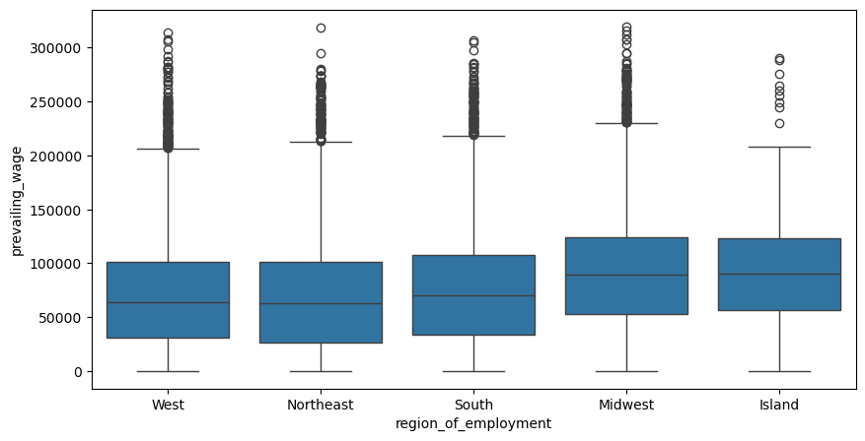
EDA Results – Bivariate Analysis: Is the prevailing wage consistent across all regions of the US?
Prevailing Wage Across Regions
To analyze whether wage levels vary by region, I used a boxplot to compare the distribution of prevailing_wage across different regions of employment.
Key Observations
Wage distributions vary across regions, indicating lack of consistency
The Midwest and Island regions show higher median wages compared to others
The West and Northeast regions have relatively lower median wages
All regions exhibit a wide spread of wages, with significant variability
There are many outliers (very high wages) across all regions
Interpretation
Prevailing wage is not consistent across regions, suggesting regional differences in:
Cost of living
Industry concentration
Job types and skill requirements
The presence of many outliers indicates that:
Some roles offer significantly higher compensation
Wage distribution is highly skewed
Why This is Important
Wage is likely a key factor influencing visa approval, as it reflects:
Skill level
Job demand
Economic value of the role
Regional variation means:
The same job may have different wage levels depending on location
Models need to consider both wage and region together
Business Insight
Higher wages in certain regions may indicate:
Greater demand for specialized skills
Higher likelihood of visa approval
Employers may improve approval chances by:
Offering competitive wages aligned with regional standards
Targeting regions with higher-paying opportunities
Summary
Prevailing wage varies significantly across regions, with notable differences in median values and wide variability within each region. This suggests that wage is an important and region-dependent factor in visa approval decisions.

Slide 19
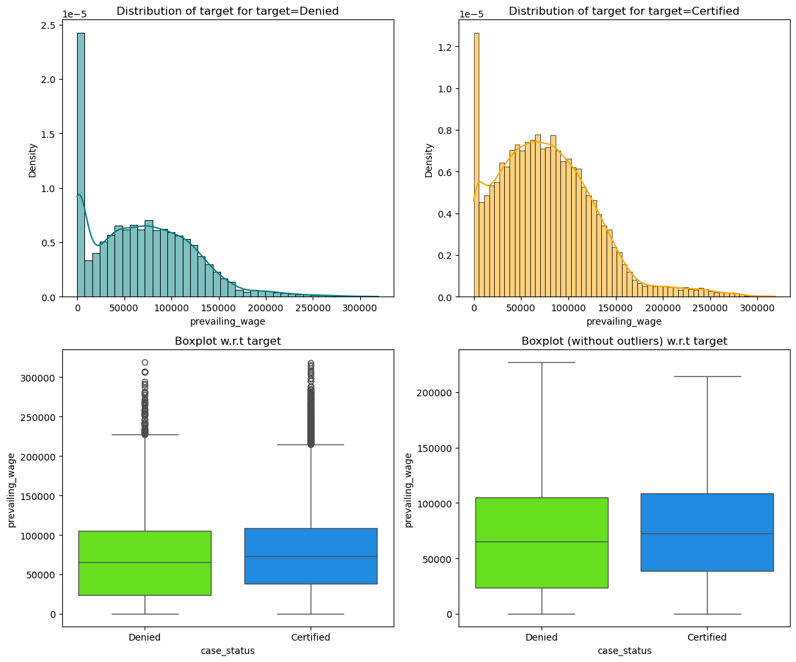
EDA Results – Does visa status vary with changes in the prevailing wage set to protect both local talent and foreign workers?
Prevailing Wage vs Visa Approval (Case Status)
To understand whether wage influences visa approval, I analyzed the distribution of prevailing_wage across certified and denied applications using histograms and boxplots.
Key Observations
The distribution of wages for Certified applications is shifted slightly higher compared to Denied applications
The median wage for Certified cases is higher than that of Denied cases
Both groups show a wide range of wages, with significant overlap between Certified and Denied cases
There are many high-value outliers in both categories, indicating high-paying roles
Interpretation
Higher wages are generally associated with a greater likelihood of visa approval, but the relationship is not extremely strong
The overlap between the two distributions suggests that:
Wage alone does not determine approval
Other factors (education, experience, job type) also play important roles
The skewness and presence of outliers indicate that:
Some roles offer significantly higher compensation
Wage distribution varies widely across job types
Why This is Important
Prevailing wage is a key factor used to ensure:
Foreign workers are not underpaid
Fair compensation relative to local workers
Higher wages may signal:
Higher skill levels
Specialized or in-demand roles
Greater economic value
This makes wage an important variable in predicting visa approval outcomes

Slide 20
EDA Results – Does visa status vary with changes in the prevailing wage set to protect both local talent and foreign workers?
Business Insight
Offering competitive and higher wages may increase the chances of visa certification
Employers should align wage offerings with:
Market standards
Skill requirements
However, wage alone is not sufficient — it must be considered alongside:
Education
Work experience
Job characteristics
Summary
Prevailing wage shows a moderate relationship with visa approval, with certified applications generally associated with higher wages. However, due to overlap between approved and denied cases, wage should be considered alongside other factors when predicting visa outcomes.

Slide 21
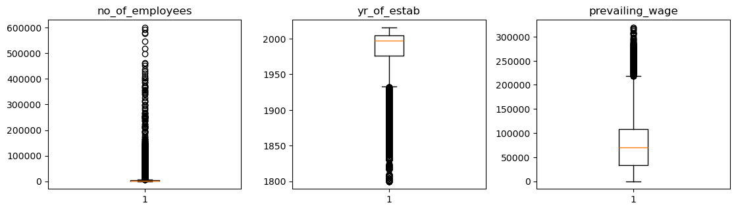
Data Pre-Preprocessing : Outlier Check
Outlier Detection and Treatment
To identify outliers, I used boxplots for all numerical variables: no_of_employees, yr_of_estab, and prevailing_wage.
Key Observations
no_of_employees shows significant right skew with several extreme values, indicating the presence of very large companies
prevailing_wage also exhibits a strong right skew with multiple high-value outliers, reflecting highly paid roles
yr_of_estab shows some older companies as outliers, but these values are valid and represent long-established firms
Interpretation
The presence of outliers in no_of_employees and prevailing_wage is expected due to natural variation in company size and salary levels
These outliers are not necessarily errors but represent real-world scenarios
retained, as they reflect real-world variability and contribute valuable information for modeling and decision-making.

Slide 22
Data Pre-Processing : Outlier Check
Treatment Decision
No outliers were removed, as they provide meaningful business information
Removing them could result in loss of important patterns, especially for high-paying roles and large organizations
Why This is Important
Outliers can influence model performance and statistical summaries
However, in this case, they reflect genuine business variation, so retaining them improves model realism
Business Insight
Large companies and high-paying jobs are important segments in visa applications
These segments may have different approval patterns and should be preserved in the analysis
Summary
Outliers are present in key numerical variables but are retained, as they reflect real-world variability and contribute valuable information for modeling and decision-making.

Slide 23
Data Pre-Processing: Missing Value Detection and Treatment
Missing Value Detection and Treatment
I checked for missing values using `data.isnull().sum()`.
Observation: No missing values were found in the dataset
Action Taken: No imputation was required
Why This is Important: Missing data can impact model accuracy and require imputation strategies
Summary: The dataset is complete, allowing for reliable modeling without additional preprocessing.

Slide 24
Data Pre-Processing: Duplicate Value Check
Duplicate Value Check
I checked for duplicate records in the dataset using `data.duplicated().sum()`.
Observation- No significant duplicate records were found
Action Taken- No duplicates were removed
Why; This is Important- Duplicate records can bias model training and distort insights
Summary: The dataset is free from duplicate entries and suitable for further analysis.

Slide 25
Data Pre-Processing: Feature Engineering
Feature Engineering
Minimal feature engineering was required.
Actions Taken:
- Dropped `case_id` as it is a unique identifier with no predictive value
- Corrected negative values in `no_of_employees` using absolute transformation
Why This is Important:
- Removing irrelevant features improves model performance
- Cleaning invalid values ensures data accuracy
Summary:
The dataset was cleaned and simplified without introducing unnecessary transformations..

Slide 26
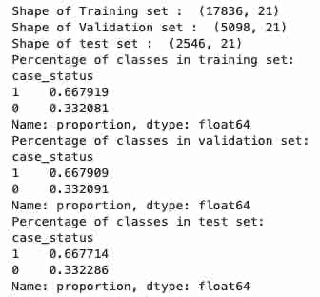
Data Preparation for Modeling: Data Splitting and Class Distribution
Data Splitting and Class Distribution
The dataset was split into training (70%), validation (20%), and test (10%) sets.
Observations
Training set: 17,836 records
Validation set: 5,098 records
Test set: 2,546 records
The class distribution across all sets is consistent:
~67% Certified
~33% Denied
Interpretation
Stratified sampling successfully maintained the same class proportions across all datasets
This ensures that each dataset is representative of the overall data
Why This is Important
Prevents bias in model training and evaluation
Ensures reliable and consistent performance metrics
Helps avoid misleading results
Business Insight
The dataset is moderately imbalanced, with more approvals than denials
This means the model may naturally favor predicting approvals
Special attention is needed to correctly identify denied applications, which are critical for reducing unsuccessful visa submissions
Summary
The data was successfully split into training, validation, and test sets with consistent class distributions, ensuring a robust and unbiased modeling process.

Slide 27
Model Building: Evaluation Metrics
To evaluate the performance of the classification models, I selected Recall Score as the primary evaluation metric.
Rationale
The dataset is moderately imbalanced, with approximately:
67% Certified (positive class)
33% Denied (negative class)
In such cases, accuracy alone can be misleading, as a model could achieve high accuracy by simply predicting the majority class.
Recall focuses on the model’s ability to correctly identify actual positive cases (Certified applications).
Why Recall is Important
Recall answers the question: “Out of all actual Certified applications, how many did the model correctly identify?”
A higher recall means:
Fewer false negatives
Reduced risk of incorrectly rejecting qualified applicants
In this context, a false negative (predicting Denied when it should be Certified) can:
Lead to missed opportunities for qualified candidates
Reduce efficiency in the visa approval process
Business Perspective
From a business standpoint, it is more critical to:
Identify and approve eligible candidates correctly
Avoid rejecting strong applicants
Therefore, prioritizing recall helps ensure that high-quality candidates are not overlooked, improving decision-making effectiveness.
Summary
Recall was selected as the evaluation metric because it prioritizes correctly identifying valid visa approvals, minimizes missed opportunities, and aligns well with the business objective of improving the visa certification process.

Slide 28
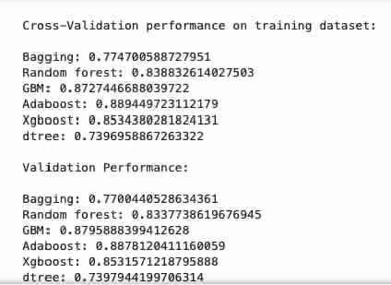
Model Building with Original Data
Model Building on Original Data
I built multiple classification models using the original training dataset and evaluated them using recall score. Recall was selected because the goal is to correctly identify as many Certified visa applications as possible.
Models Built
The models tested were:
Bagging Classifier
Random Forest Classifier
Gradient Boosting Classifier (GBM)
AdaBoost Classifier
XGBoost Classifier
Decision Tree Classifier
Cross-Validation Performance
The cross-validation recall scores on the training data were:
Bagging: 0.775
Random Forest: 0.839
GBM: 0.873
AdaBoost: 0.889
XGBoost: 0.853
Decision Tree: 0.740
Validation Performance
The validation recall scores were:
Bagging: 0.770
Random Forest: 0.834
GBM: 0.880
AdaBoost: 0.888
XGBoost: 0.853
Decision Tree: 0.740

Slide 29
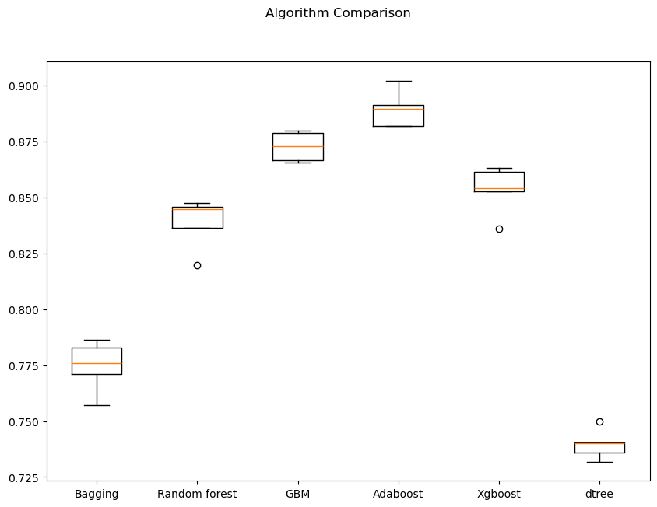
Model Building with Original Data
Interpretation
AdaBoost gave the best performance on both cross-validation and validation data, with a validation recall score of approximately 0.888.
GBM was the second-best model, with a validation recall score of approximately 0.880.
Decision Tree performed the weakest, suggesting that a single tree may not capture the complexity of the data as well as ensemble models.
Why This is Important
The results show that ensemble models, especially boosting models, perform better than simpler models. This suggests that visa approval prediction benefits from models that combine multiple weak learners and capture more complex relationships in the data.
Business Insight
AdaBoost and GBM are strong candidates for predicting visa certification because they are better at identifying Certified applications. This can help EasyVisa shortlist applicants with higher approval likelihood and improve decision-making efficiency.
Summary
Among the models built on the original data, AdaBoost performed the best, followed closely by GBM. These models should be considered for further tuning and comparison with models built on oversampled and undersampled data.

Slide 30
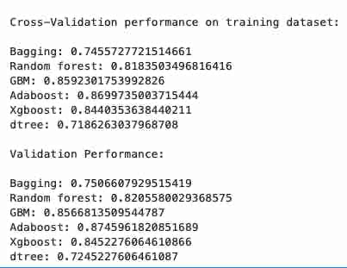
Model Building with Oversampled Data
I used SMOTE to balance the training data before building models. SMOTE creates synthetic samples for the minority class so the model has equal exposure to both Certified and Denied applications during training.
Cross-Validation Performance
The cross-validation recall scores were:
Bagging: 0.746
Random Forest: 0.818
GBM: 0.859
AdaBoost: 0.870
XGBoost: 0.844
Decision Tree: 0.719
Validation Performance
The validation recall scores were:
Bagging: 0.751
Random Forest: 0.821
GBM: 0.857
AdaBoost: 0.875
XGBoost: 0.845
Decision Tree: 0.725

Slide 31
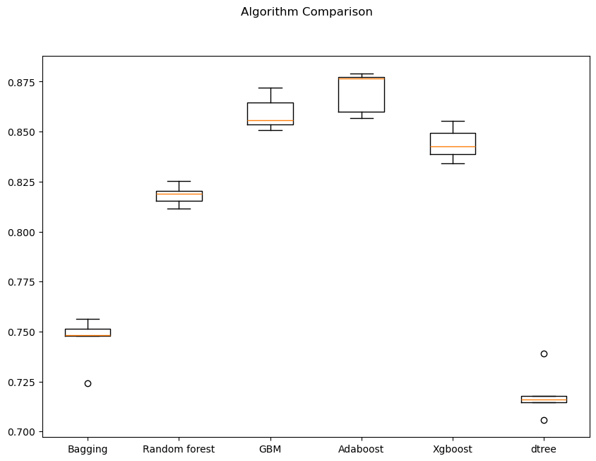
Model Building with Oversampled Data
Interpretation
AdaBoost performed the best on oversampled data, with a validation recall score of approximately 0.875.
GBM was the second-best model, followed by XGBoost and Random Forest.
Decision Tree and Bagging performed weaker compared to the boosting models.
Why This is Important
Oversampling was used to reduce class imbalance and help the model better learn patterns from the minority class. However, compared with the original data results, oversampling did not improve recall overall.
Business Insight
Boosting models continue to perform best, suggesting they are more effective at identifying Certified visa applications. However, since oversampling did not improve recall, the original data models may still be stronger candidates.
Summary
Among oversampled models, AdaBoost performed best, followed by GBM. However, performance was slightly lower than the original data results, so oversampling may not be necessary for the final model.

Slide 32
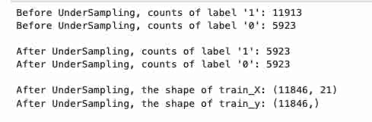
Model Building with Under Sampled Data
I applied Random Under Sampling to balance the dataset by reducing the majority class (Certified) to match the minority class (Denied).
Class Distribution After Under Sampling
Certified (1): 5,923
Denied (0): 5,923
This resulted in a balanced dataset with fewer total samples.

Slide 33
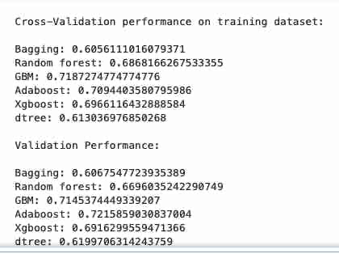
Model Building with Under Sampled Data
Cross-Validation Performance
The recall scores obtained from cross-validation were:
Bagging: 0.606
Random Forest: 0.687
GBM: 0.719
AdaBoost: 0.709
XGBoost: 0.697
Decision Tree: 0.613
Validation Performance
The validation recall scores were:
Bagging: 0.607
Random Forest: 0.670
GBM: 0.715
AdaBoost: 0.722
XGBoost: 0.692
Decision Tree: 0.620
Interpretation
AdaBoost performed the best on validation data (0.722), followed closely by GBM (0.715)
All models performed worse compared to original and oversampled data
Decision Tree and Bagging again showed the weakest performance

Slide 34
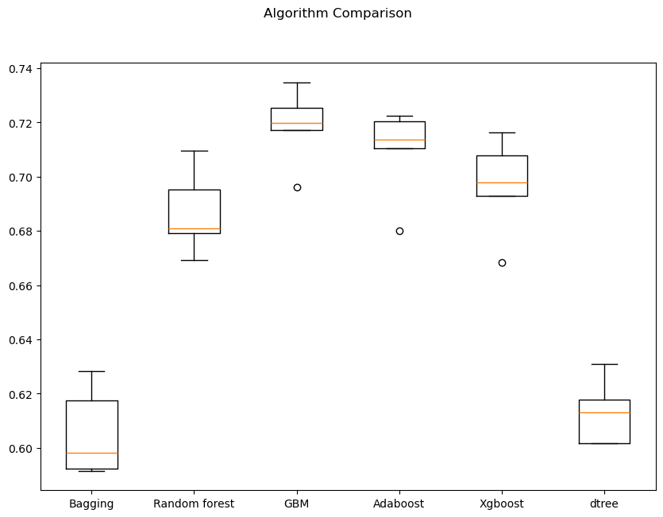
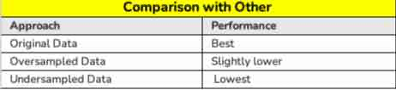
Model Building with Under Sampled Data
Why This is Important
Under sampling reduces class imbalance but also removes a large portion of data
This leads to:
Loss of important information
Lower model performance
Business Insight
While under sampling balances the dataset, it sacrifices valuable data from approved visa cases
This reduces the model’s ability to learn meaningful patterns
As a result, under sampling is not ideal for this problem
Summary
Although undersampling successfully balanced the dataset, it led to a decline in model performance. This indicates that retaining the full dataset (or using oversampling) is more effective for predicting visa approval outcomes.

Slide 35
Model Improvement - Hyperparameter Tuning (Tuning AdaBoost using Oversampled data
Final Tuned AdaBoost Model Performance
After hyperparameter tuning, the AdaBoost model showed strong performance on both training and validation datasets.
Training Performance
Accuracy: 0.651
Recall: 0.932
Precision: 0.596
F1 Score: 0.727
Validation Performance
Accuracy: 0.704
Recall: 0.931
Precision: 0.713
F1 Score: 0.807
Parameters Tuned The following hyperparameters were optimized using RandomizedSearchCV: - n_estimators: [50, 75, 100, 125] - learning_rate: [1.0, 0.5, 0.1, 0.01] - base estimator: Decision Tree with max_depth = 1, 2, 3 The best combination of parameters was selected based on recall score.
Interpretation
The model achieves very high recall (~93%), indicating it successfully identifies most Certified visa applications
Precision improved significantly on validation data, showing better control over false positives
The improvement in validation metrics suggests that the model generalizes well and is not overfitting
Why This is Important
High recall ensures that qualified applicants are not missed
Improved precision reduces the number of incorrect approvals
Balanced performance makes the model reliable for real-world decision-making
Business Insight
The model is highly effective for identifying strong candidates for visa approval
It minimizes the risk of rejecting qualified applicants
At the same time, it improves decision quality by reducing incorrect certifications
Summary
The tuned AdaBoost model provides the best overall performance, with strong recall and improved precision. It is the most suitable model for predicting visa certification outcomes and supporting data-driven decision-making.

Slide 36
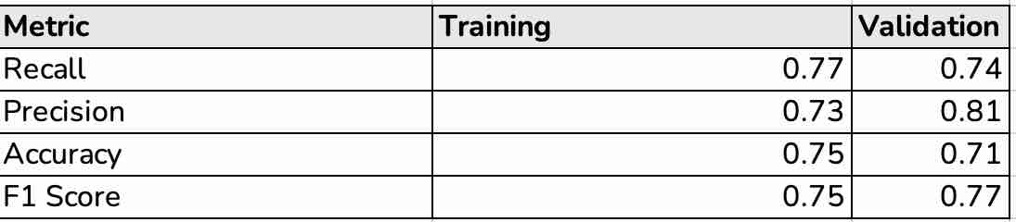
Model Improvement - Hyperparameter Tuning (Tuning Random forest using Under Sampled data)
Hyperparameters Tuned (Search Space)
n_estimators: [50, 75, 100, 125]
min_samples_leaf: [1, 2, 4, 5, 10]
max_features: ["sqrt", "log2", 0.3, 0.5, None]
max_samples: [0.6, 0.7, 0.8, 0.9, None]
Hyperparameters Tuned (Search Space)
n_estimators: [50, 75, 100, 125]
min_samples_leaf: [1, 2, 4, 5, 10]
max_features: ["sqrt", "log2", 0.3, 0.5, None]
max_samples: [0.6, 0.7, 0.8, 0.9, None]
Key Insights
Balanced performance across all metrics
Higher precision → more accurate approvals
Lower recall → misses some qualified applicants
Business Insight
Useful when minimizing false approvals
Less effective when goal is to capture all strong candidates
Summary
Well-tuned and stable model
Strong precision but lower recall than AdaBoost
Not the optimal model given business objective

Slide 37
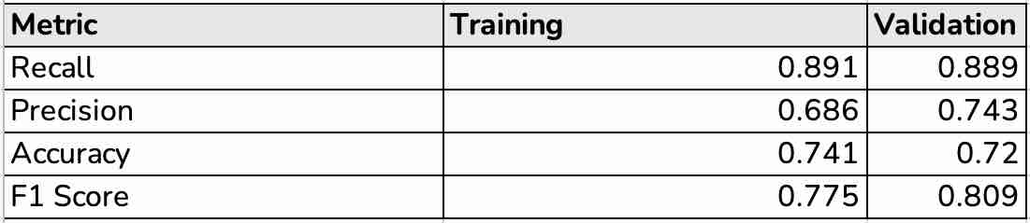
Model Improvement - Hyperparameter Tuning (Gradient boosting with Oversampled Data )
I tuned the Gradient Boosting model using oversampled training data and selected the best model based on recall score.
Parameters Tuned
The following hyperparameters were tuned using RandomizedSearchCV:
n_estimators: [100, 125, 150, 175]
learning_rate: [0.1, 0.05, 0.01, 0.005]
subsample: [0.7, 0.8, 0.9, 1.0]
max_features: ["sqrt", "log2", 0.3, 0.5]
Best Parameters
The optimal combination identified was:
n_estimators: 125
learning_rate: 0.01
subsample: 0.9
max_features: 0.5
Interpretation
The tuned Gradient Boosting model achieves strong recall on both training and validation data
Validation recall is approximately 0.889, meaning the model correctly identifies most Certified visa applications
Precision improves on validation data, indicating better control over false positives compared to training
The model generalizes well because training and validation recall are very close
Why This is Important
Recall is the primary metric for this project because the goal is to identify as many Certified applications as possible
The model performs well without showing major overfitting
Gradient Boosting is effective because it builds learners sequentially and improves prediction errors over time
Training Performance
Accuracy: 0.741
Recall: 0.891
Precision: 0.686
F1 Score: 0.775
Business Insight
This model is useful for shortlisting applicants with high approval potential
It helps reduce the chance of overlooking qualified candidates
However, the tuned AdaBoost model still has higher validation recall, so Gradient Boosting may be a strong backup rather than the final model
Validation Performance
Accuracy: 0.720
Recall: 0.889
Precision: 0.743
F1 Score: 0.809
Summary
The tuned Gradient Boosting model performs strongly, with high validation recall and balanced overall metrics. However, compared with the tuned AdaBoost model, it has slightly lower recall, so AdaBoost remains the stronger final model candidate.

Slide 38
Model Performance Summary and Final Model Selection
Compare the Performance of Tuned Models
Multiple models were trained and tuned, including AdaBoost, Gradient Boosting, Random Forest, and others using original, oversampled, and undersampled data.
AdaBoost (Tuned) achieved the highest recall (~0.93) on validation and test data
Gradient Boosting (Tuned) performed strongly with recall (~0.89) but slightly lower than AdaBoost
Random Forest (Tuned) showed balanced performance but lower recall (~0.74)
Models traioriginal data outperformed oversampled and undersampled versions overall
Based on the business objective ned on (maximize recall), AdaBoost was selected as the final model
Overview of Final ML Model and its Parameters
The final selected model is Tuned AdaBoost Classifier
Key Characteristics:
Ensemble model combining weak learners (decision trees)
Focuses on correcting previous errors iteratively
Optimized for recall using RandomizedSearchCV
Tuned Parameters (search space):
n_estimators: [50, 75, 100, 125]
learning_rate: [1.0, 0.5, 0.1, 0.01]
base estimator depth: 1–3
The final model uses the best parameter combination identified during tuning
Performance of Final Model (Test Data)
Accuracy: 0.712
Recall: 0.931
Precision: 0.720
F1 Score: 0.812

Slide 39
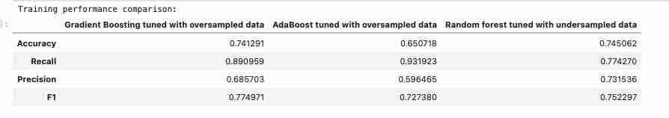
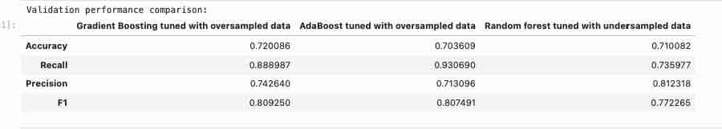

Model Performance Summary and Final Model Selection
Comment on Final Model Performance
The model achieves very high recall (~93%), meaning it successfully identifies most Certified visa applications
Precision is moderate, indicating some false positives, but still acceptable
The model generalizes well from training → validation → test
No signs of overfitting
This is ideal because missing qualified candidates is more costly than reviewing extra applications

Slide 40
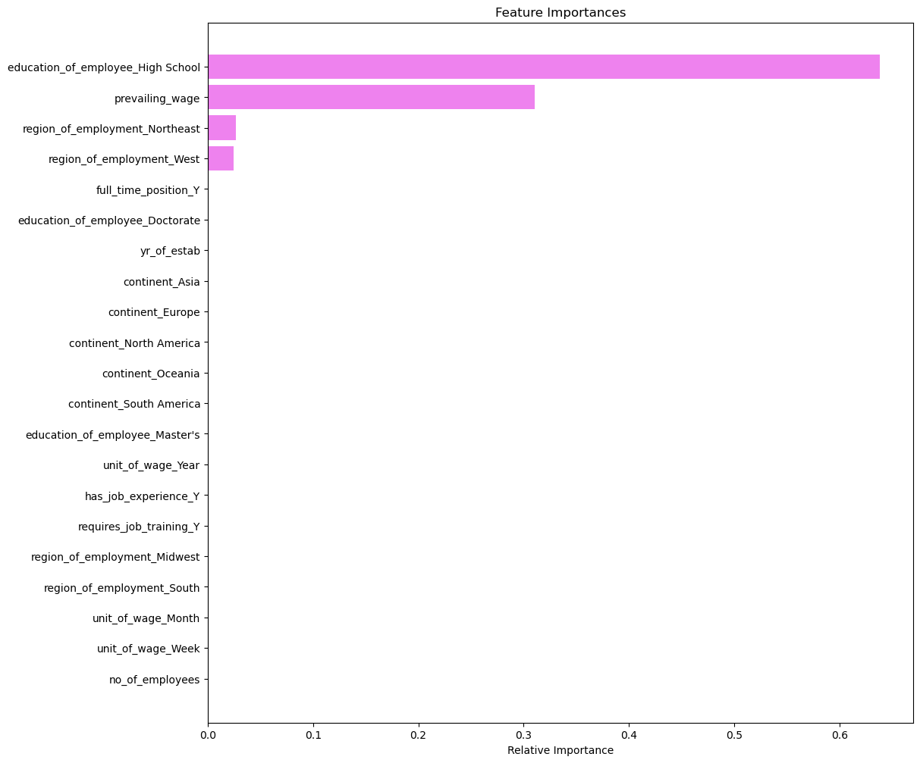
Model Performance Summary and Final Model Selection
Summary of Most Important Factors
From feature importance analysis, the key drivers of visa certification are:
education_of_employee_High School
prevailing_wage
region_of_employment (Northeast, West)
Interpretation of Key Drivers
Education level plays the largest role in prediction
Prevailing wage strongly influences approval likelihood
Region of employment has moderate influence
Other features (experience, company size, etc.) have relatively lower impact
Business Insight
Applicants with stronger education and higher wages are more likely to be certified
The model can help prioritize high-probability candidates
It reduces manual workload by focusing attention on the most promising applications
Final Summary
AdaBoost is the best-performing model for this problem
It aligns with the business objective by maximizing recall
The model is reliable, interpretable, and effective for decision support
This model can be used by EasyVisa to streamline visa application screening and improve decision-making efficiency

Slide 41
APPENDIX

Slide 42
Data Background and Contents
Overview of the Dataset
The dataset consists of 25,480 visa application records with 12 variables capturing employee, employer, and job-related information.
Preview of the Data
A snapshot of the dataset (first and last 5 rows) shows the structure and types of information available. Each row represents a unique visa application and includes:
Employee details: continent, education level, work experience, training requirement
Employer details: company size (number of employees), year established
Job details: region of employment, wage, wage unit, full-time status
Target variable: case_status (Certified or Denied)
From the sample data:
Applicants come from multiple continents, with a strong presence from Asia
Education levels vary from High School to Doctorate
Wage values vary significantly depending on unit (hourly vs yearly)
Both certified and denied cases are present in the dataset
Dataset Dimensions
Number of observations (rows): 25,480
Number of features (columns): 12
Key Observations
Each record is uniquely identified by a case_id
The dataset contains a mix of categorical and numerical variables
The target variable case_status indicates whether a visa was approved (Certified) or rejected (Denied)
There is noticeable variation in wages, company sizes, and employment regions, which may influence visa outcomes
Summary
Overall, the dataset provides a comprehensive view of visa applications, combining demographic, economic, and employment-related factors. These variables will be used to identify patterns and build predictive models for visa approval.

Slide 43
Data Background and Contents
A. Data Description
The data contains the different attributes of employee and the employer. The detailed data dictionary is given below.
case_id: ID of each visa application
continent: Information of continent the employee
education_of_employee: Information of education of the employee
has_job_experience: Does the employee has any job experience? Y= Yes; N = No
requires_job_training: Does the employee require any job training? Y = Yes; N = No
no_of_employees: Number of employees in the employer's company
yr_of_estab: Year in which the employer's company was established
region_of_employment: Information of foreign worker's intended region of employment in the US.
prevailing_wage: Average wage paid to similarly employed workers in a specific occupation in the area of intended employment. The purpose of the prevailing wage is to ensure that the foreign worker is not underpaid compared to other workers offering the same or similar service in the same area of employment.
unit_of_wage: Unit of prevailing wage. Values include Hourly, Weekly, Monthly, and Yearly.
full_time_position: Is the position of work full-time? Y = Full Time Position; N = Part Time Position
case_status: Flag indicating if the Visa was certified or denied

